Slide 1
nested PCR
Ali I.A. Gharip, B.Sc
Biotech T.A
Omdurman Islamic University

Slide 2

dedication
To spirit of my mother

Slide 3
Key Topics:
What is nested PCR?
Protocol for the nested PCR:
Advantages of the nested PCR:
Disadvantages of nested PCR:
Role of nested PCR in microbial identification
Conclusion:
Share this:

Slide 4
What is nested PCR?
In the nested PCR, the specificity of the PCR reaction is enhanced by reducing the non-specific binding with the help of the two sets of primer.
The first set of primer binds outside of our target DNA and amplifies larger fragment, this set of primer is referred to as an outer primer.
The specificity is the main aim of any of the PCR reaction. Every PCR modifications are mean to increase the specificity as well as the sensitivity of the reaction.
The nested PCR is the best choice in the microbial identification and 16s RNA analysis. We will discuss it in the latter part of this article.

Slide 5
Another set of primer binds specifically at the target site and in the second round of amplification, it amplifies only the target DNA, this set of primer is referred to as an inner primer.
Here, in the nested PCR, our template DNA is the primary binding site for the outer set of primers while the amplicon of the first set of the PCR is the site for binding for the inner set of primers.
Interestingly, the technique does not require any additional reagent, chemical or instrumentation besides conventional PCR reactions.

Slide 6
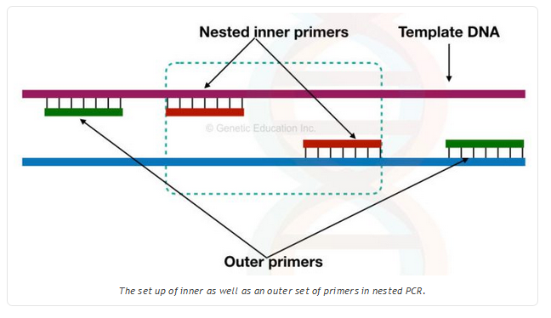

Slide 7
Interestingly, the technique does not require any additional reagent, chemical or instrumentation besides conventional PCR reactions.
Only one extra single set of primer is sufficient.
Here, the common problem with the single set of primer or conventional PCR is the early activation of Taq DNA polymerase, primer-dimer and the non-specific bindings of primer to the template DNA.
Related article: “Primer Dimer”: Zones DNA amplification by pairing with foe oligo.

Slide 8
The outer set of primer:
The outer primers are primers that are upstream to the inner set of primers. The outer primers are bind to the outside to the flanking region of out target DNA.
In the first round of PCR, It is possible that this primer can bind to the site other than the target site and amplifies it. Multiple DNA bands might be observed and lead to false-positive results.
However, the magic begins with the use of the inner set of primer.

Slide 9
The inner set of primer:
Even if the non-specific DNA sequences can be amplified in the first round of PCR, that non-specific DNA will not be amplified in the second set of amplification.
The second set of primer is specific to the inner sequence (amplicon of the first round of PCR).
It is very unlikely that the inner set of primers binds to other than its specific site because the amplicon from the first round of PCR is the template for the second round of amplification.

Slide 10
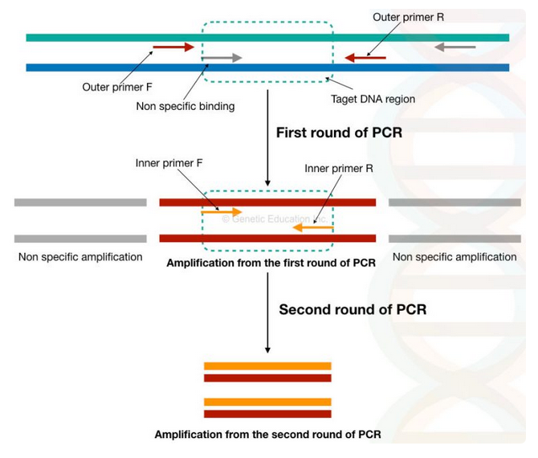

Slide 11
Protocol for the nested PCR:
In the year 1993, Kamolvarin and coworkers described the method for use of two sets of primers for increasing sensitivity and specificity of the PCR.
The nested PCR reaction is complete into two steps, a first round of amplification with the outer forward and reverse primers. The protocol is as described,

Slide 12
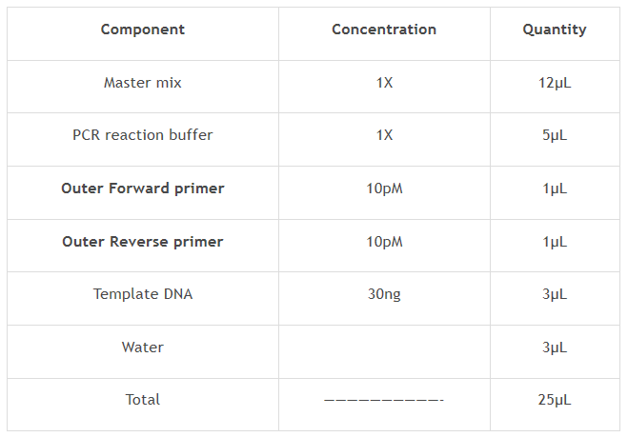

Slide 13
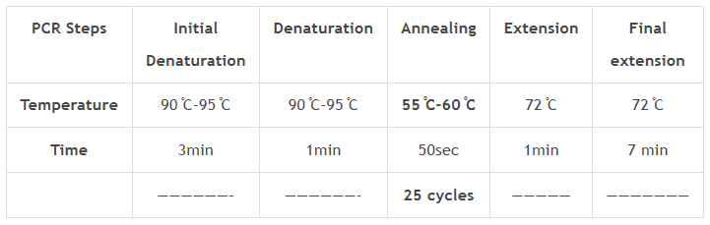
After the reaction preparation, put the PCR as shown into the table below, note that the cycles number is 25 cycles

Slide 14
After the completion of the first round of amplification, take the tubes and prepare the reaction for the second round of amplification.
Now add 1µL inner forward primer and 1µL inner reverse primer to the PCR reaction tubes of the first round of amplification.
Or
We can use another method in which, 3µL of PCR product is taken from the first amplification and use it as a template, prepare the reaction as followed.

Slide 15
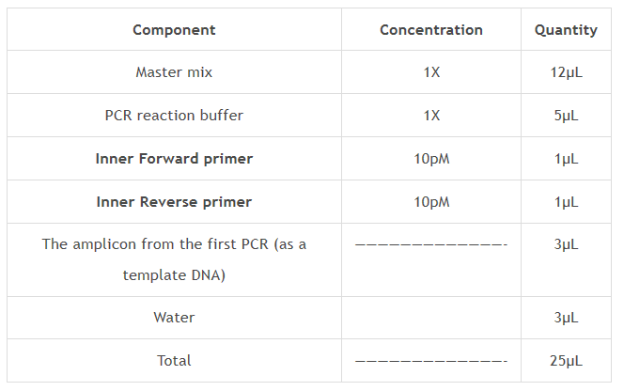
Place it back into the PCR machine.

Slide 16
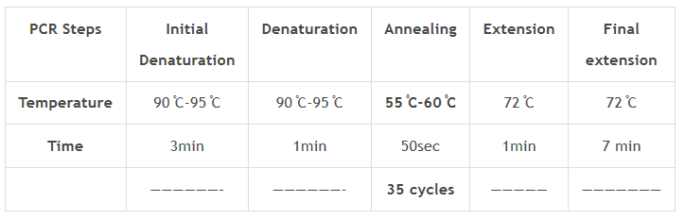
Instead of 25 cycles, set the PCR at 35 cycles. Higher amplification is achieved by increasing the cycles in the second round of PCR. we can amplify more amount of gene of our interest.

Slide 17
Advantages of the nested PCR:
It is beneficial in studies such as phylogenetic analysis and genetic polymorphism.
The main advantage of the present method is that it gives 100% accuracy, specificity and sensitivity.
For the impossible templates where the GC content might be high or chance of non-specific banding is higher, nested PCR offers the best results.
It is also useful in the amplification of genes with the low abundance.
Further, nested PCR is the best choice for carcinoma and viral infection studies.
Yet, due to several limitations, the nested PCR is not the first choice for many reactions.

Slide 18
Disadvantages of nested PCR:
The method is time-consuming.
Required more reagents such as an extra set of primer and one extra round of agarose gel electrophoresis. Which means the method is quite costly.
The chance of contamination is also higher.

Slide 19
Role of nested PCR in microbial identification
The nested qPCR or the nested RT-PCR gives great power to this technique which can be a helpful method for the phylogenetic analysis and identification of different pathogens.
The technique has higher sensitive hence even if the sample contains lower DNA, it can amplify, which is not possible by the conventional PCR technique. In addition to this, the method is highly specific.
In the nested real-time PCR, the universal primers for 16S and 18S rRNA are used as an outer primer.

Slide 20
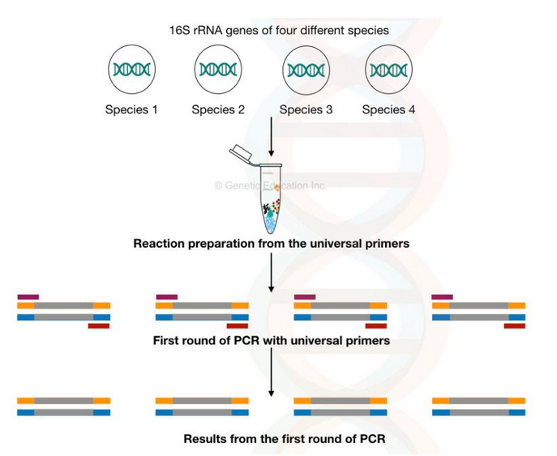

Slide 21
Once it amplifies into the PCR machine, the set of species-specific or unique sequence primers are used as an inner set of primers.
The second round of PCR or multiplex PCR (more set of primers for different species), individual PCR or the target-specific PCR technique can be applied.
The unique sequence primers are specific to one pathogen which amplifies the template DNA if the target sequence is present.
Once the amplification is achieved, the amount of pathogen present in the sample is measured quantitatively-ultimately the species of the pathogen can be identified.

Slide 22
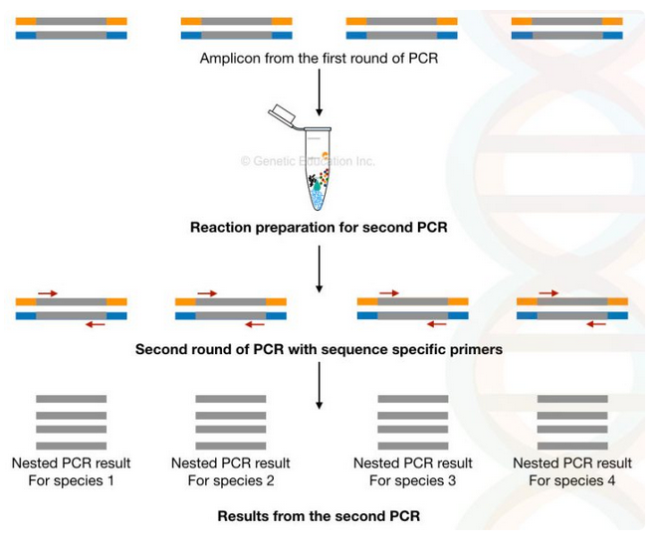

Slide 23
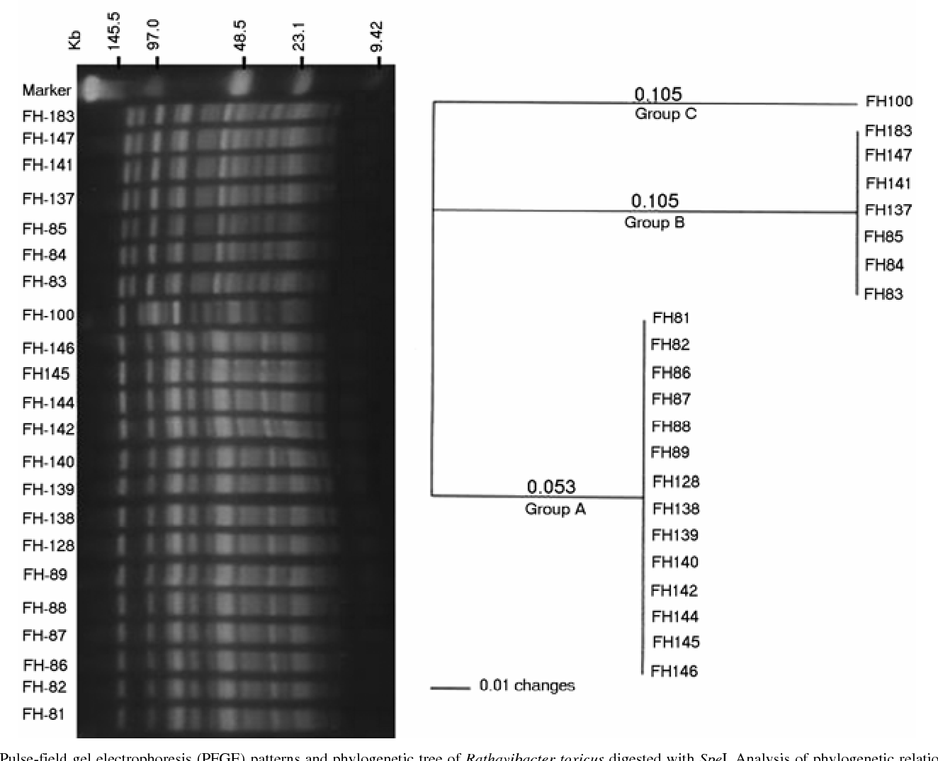
By using the universal primer and sequence-specific primer phylogenetic tree for different species of the pathogen can be prepared as well.

Slide 24
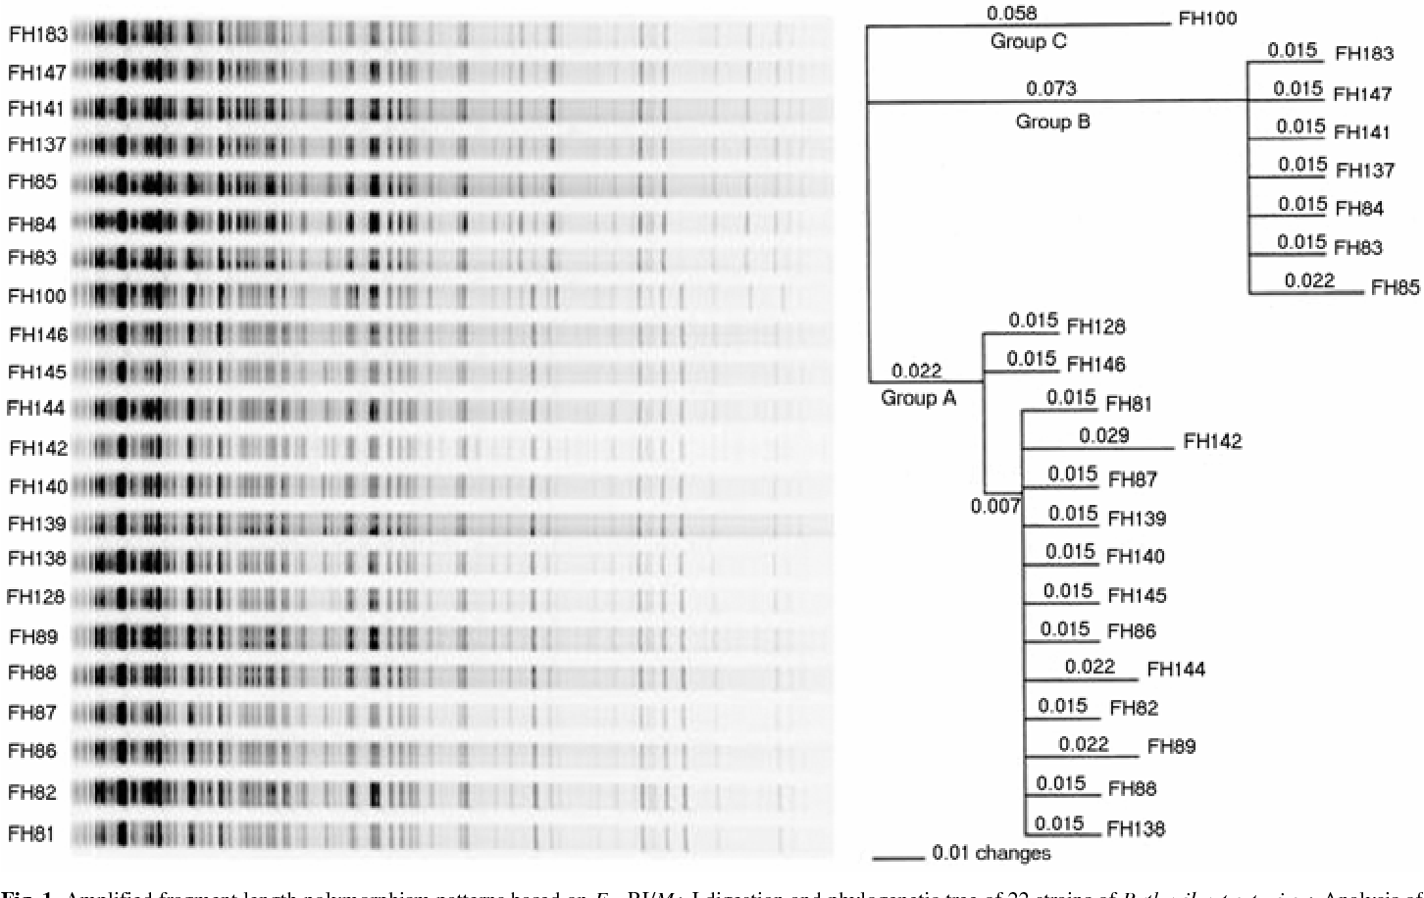

Slide 25
Conclusion:
Although the nested PCR is the best choice for achieving the specificity, it consumes more time. It is restricted, the technique is not suitable for long-range PCR.
Still, the nested PCR is one of the gold standard method used in the identification of pathogens. The combined multiplex-nested PCR method is used in the study of 16s rRNA and 18s rRNA of HCV and HSV.

